Slide 1
IMAGE Tradeshow
28 August - 1 September 2022
George R. Brown Convention Center, Houston, TX
Booth #1122

Slide 2
IMAGE Tradeshow
Michael J. Pyrcz, Associate Professor
Cockrell School of Engineering and Jackson School of Geosciences, The University of Texas at Austin
Murray Christie, Executive Director
Geoscience & Engineering Commercialization, Energy

Slide 3
Agenda
Robust Data Analytics and Machine Learning Workflow for Basin-Scale Carbon Storage Potential
Challenges:
Combining multiple data sources?
What matters?
Consistent mapping of CS potential?
Improved data analytics for new insights and optimum development.

Slide 4
Opportunities
operational decisions required for CCUS potential assessment are improved with robust use of data analytics to address the challenges of multiscale, incomplete, biased, or uncertain data
integration of robust spatial data analytics, geostatistics and machine learning to support carbon storage potential in the Middle Miocene Gulf of Mexico
Basin Scale CCUS Spatial Data Analytics and Modeling
Basin Scale CCUS Feature Selection
Basin Scale CCUS Potential Maps

Slide 5
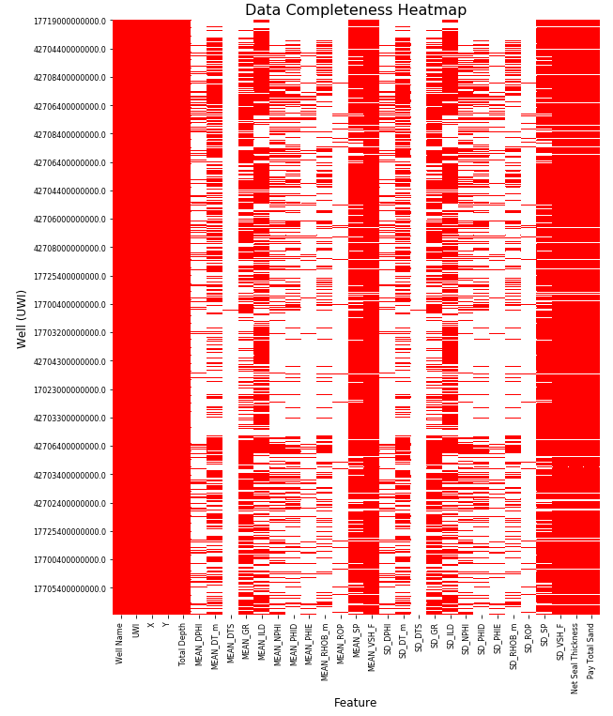
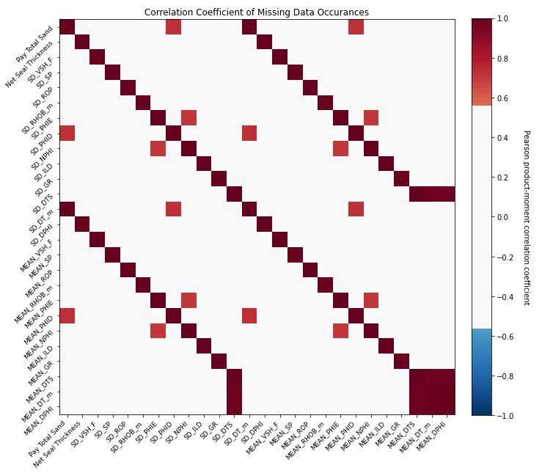
Integration of All Available Well Data
evaluation of available data coverage and missing information.
Well data missing data correlation matrix.
Well data completeness heatmap.

Slide 6
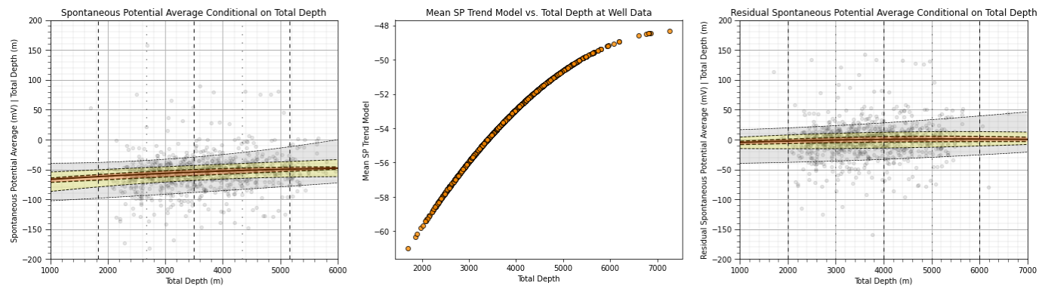
Gamma Ray Imputation
spontaneous potential (SP) well log depth trend model and calculation of a stationary residual to inform gamma ray (GR)
Conditional distributions for spontaneous potential vs. depth (left), model of expected SP as a function of depth (center), residual spontaneous potential (right).

Slide 7
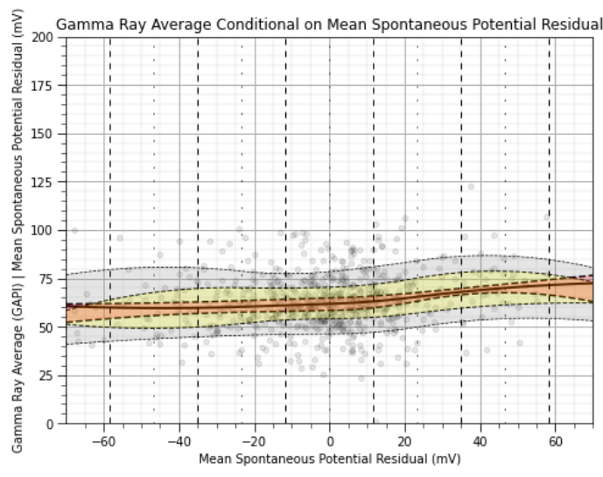
Gamma Ray Imputation
spontaneous potential (SP) residual does not have a significant relationship with gamma ray, not currently suitable for imputation.
Conditional distributions for gamma ray vs. spontaneous potential residual.

Slide 8
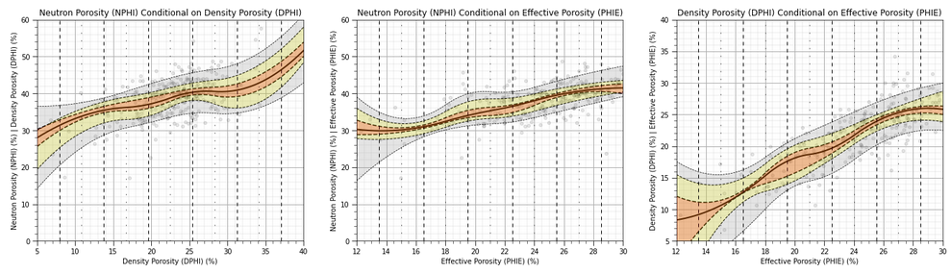
Effective Porosity Imputation
evaluated the relationship between collocated porosity measures, neutron, density and effective.
indicates an opportunity to apply density and neutron porosity (with greater coverage) to impute missing effective porosity.
Conditional distributions for the combinations of porosity meatures indicating strong relationships.

Slide 9
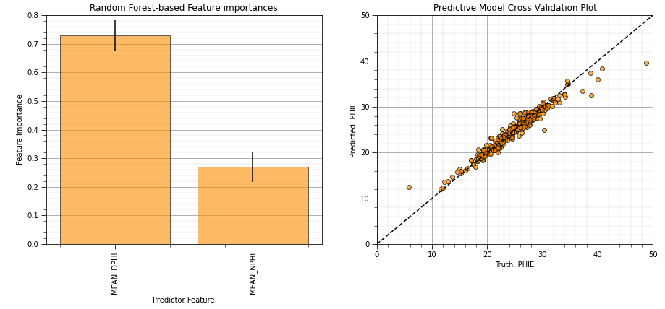
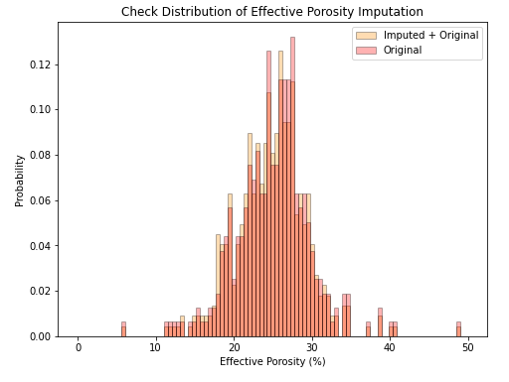
Effective Porosity Imputation
evaluated the relationship between collocated porosity measures, neutron, density and effective.
indicates an opportunity to apply density and neutron porosity (with greater coverage) to impute missing effective porosity.
fit a random forest imputation model to estimate missing effective porosity with density and neutron porosity.
Feature importance (left), cross validation (center) and distribution (right) checks for random forest effective porosity imputation model.

Slide 10
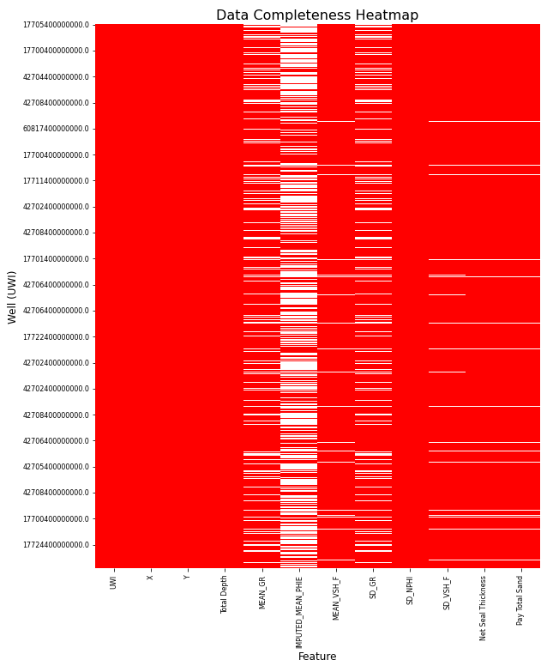
Well Data Coverage
check of impute effective porosity coverage after imputation with avaible neutron and density porosity
Heat map of feature coverage after effective porosity imputation.

Slide 11
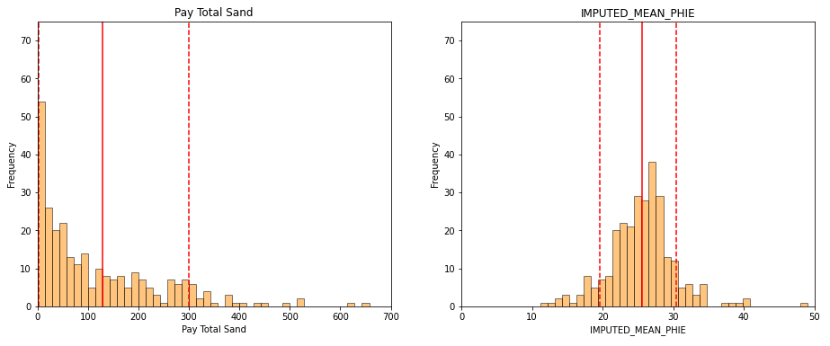
Response Features
construction of probabilitistic maps of pay total sand (m) and imputed effective porosity (%).
Well response feature distributions with P10, P50 and P90 indicated.

Slide 12
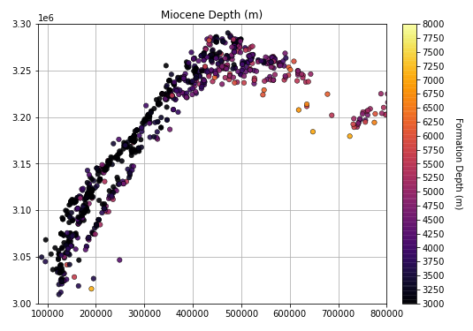
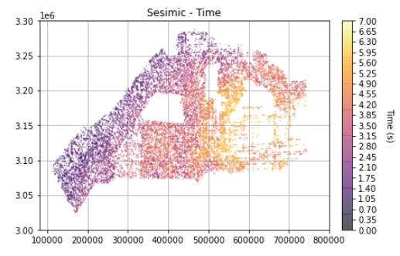
Integration of All Available Seismic and Well Data
evaluation of available GOM Miocene data coverage and missing information.
Well data location map with Miocene depth indicated.
Seismic data location maps with Miocene time indicated.

Slide 13
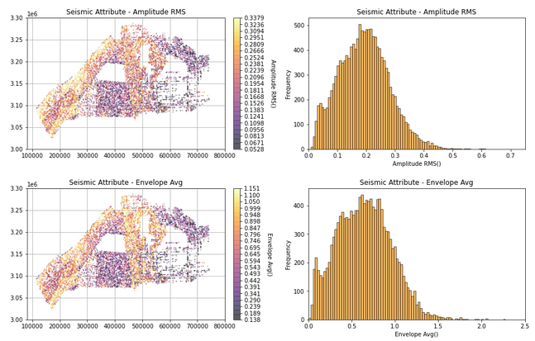
Seismic Attribute Calculation
extraction of various seismic attributes as engineered features
amplitude, envelope, relative acoustic impedance, smooth dip of maximum similarity, parallel bed indicator, smooth similarity
summarized as average and root mean square over the formation of interest.
Example engineered seismic features location maps and distributions.

Slide 14
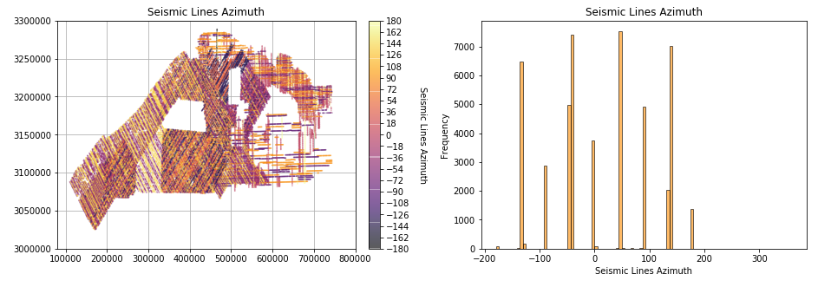
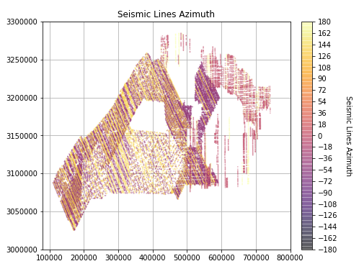
Seismic Data Integration
survey segmentation and evaluation, dip and strike surveys
select consistent surveys to reduce spatial contradiction
Seismic lines labelled by orientation and histogram of Miocene data for each seismic line orientation.
Extracted dip seismic lines.

Slide 15
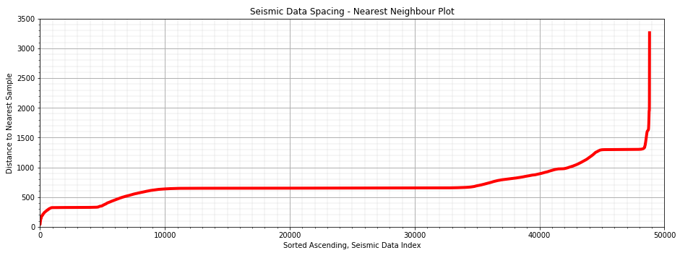
Seismic Data Integration
Quantification of data spacing with nearest neighbor plot.
quantification of data spacing with nearest neighbor plot, the Euclidian distance to nearest data from each seismic data point
in general, the decimated, selected seismic lines have a data spacing is 300 m – 600 m

Slide 16
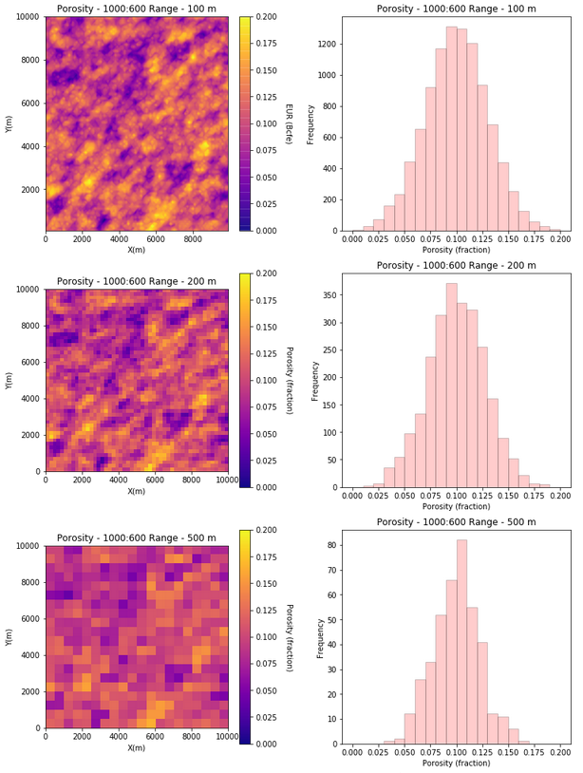
Volume Variance Relations
What scale to model?
as the volume support, scale increases the variance decreases
this rate of reduction depends on the scale of the heterogeneity
we empirically upscale the data and evaluate the reduction in variance to select an optimum scale for the basic scale model
Example of volume variance relations.

Slide 17
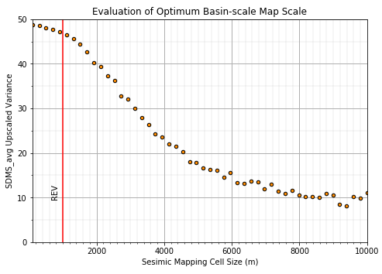
Seismic Data Integration
Example seismic attribute vs. seismic map cell size with volume variance relations.
apply volume-variance relations to calculate the optimum basin-scale map cell size
with 1000m cell size we retain over 95% of the original variance with about 140k model cells

Slide 18
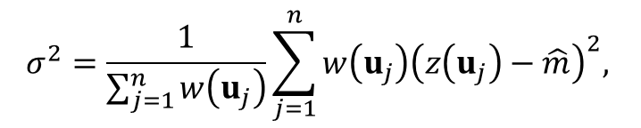
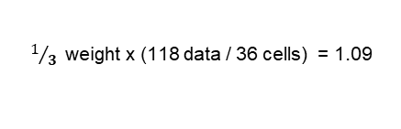

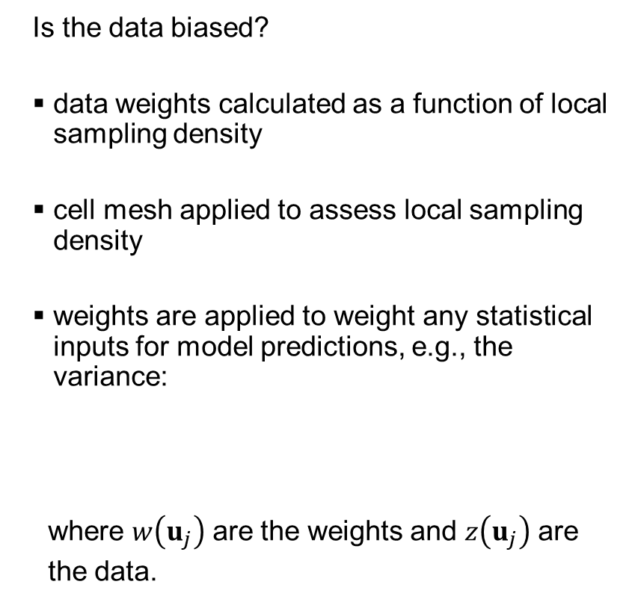
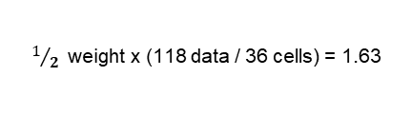
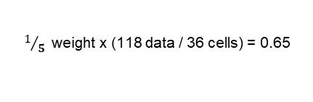
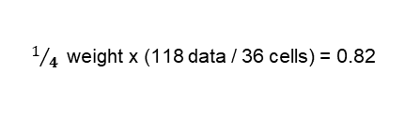
Declustering and Debiasing Spatial Data
Is the data biased?
data weights calculated as a function of local sampling density
cell mesh applied to assess local sampling density
weights are applied to weight any statistical inputs for model predictions, e.g., the variance:
where $w\left(u_{j}\right)$ are the weights and $z\left(u_{j}\right)$ are
the data.
$1$weight x (118 data / 36 cells) = 3.27
$1/3$weight x (118 data / 36 cells) = 1.09
$1/4$weight x (118 data / 36 cells) = 0.82
$1/5$weight x (118 data / 36 cells) = 0.65
$1/2$weight x (118 data / 36 cells) = 1.63
$$σ^{2}=\frac{1}{\sum_{j=1}^{n}{w\left(u_{j}\right)}}\sum_{j=1}^{n}{w\left(u_{j}\right){\left(z\left(u_{j}\right)−\hat{m}\right)}^{2}, }$$
Example of cell-based declustering, weights based on local data sampling density (modified from Pyrcz and Deutsch (2014).

Slide 19
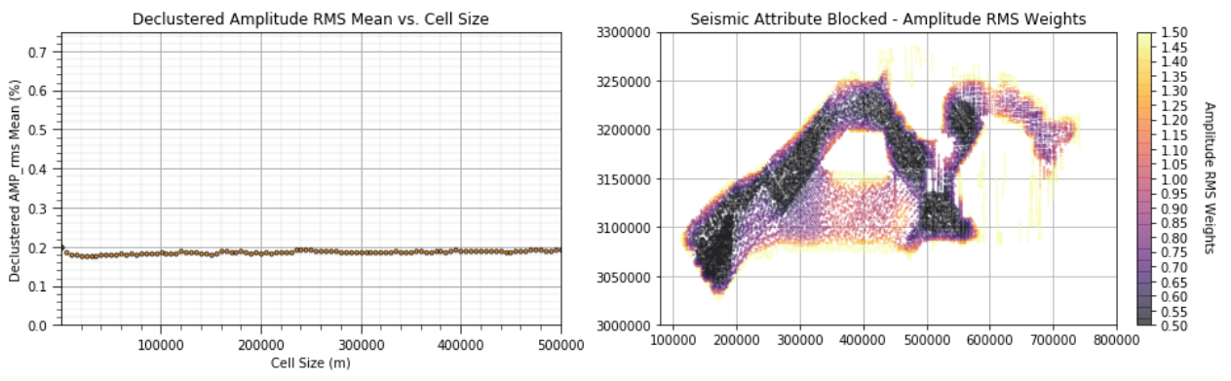
Seismic and Well Data Declustering
Data Bias
Example seismic attribute declustered mean vs. cell size (left) and resulting data declustering weights (right).
evaluation of sampling bias due to clustered sampling with cell-based declustering
results in 10% reduction in global mean and variable data weights for global statistics for geostatistical mapping, estimation and simulation

Slide 20
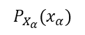
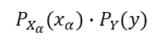
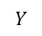
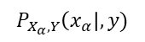
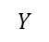
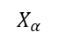
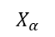
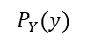
Going Beyond Correlation
What feature matter? What should we focus on?
correlation coefficient is limited to linear structure and is quite sensitive to outliers, also it only accounts for relevance (relationship between the predictor feature and the response feature).
partial correlation coefficient extends correlation by integrating redundancy, the relationship between the current predictor and all other predictor features
mutual information from information theory avoids any distributions assumptions, and relies on the general definition of independence!
$$Y$$
$$Y$$
$$P_{Y}(y)$$
$$P_{X_{α}}(x_{α})∙P_{Y}(y)$$
$$P_{X_{α}, Y}\left(x_{α}\right|, y)$$
$$P_{X_{α}}(x_{α})$$
$$X_{α}$$
$$X_{α}$$
Mutual information compares the random joint probabilities (left) to the observed joint probabilities (right).

Slide 21
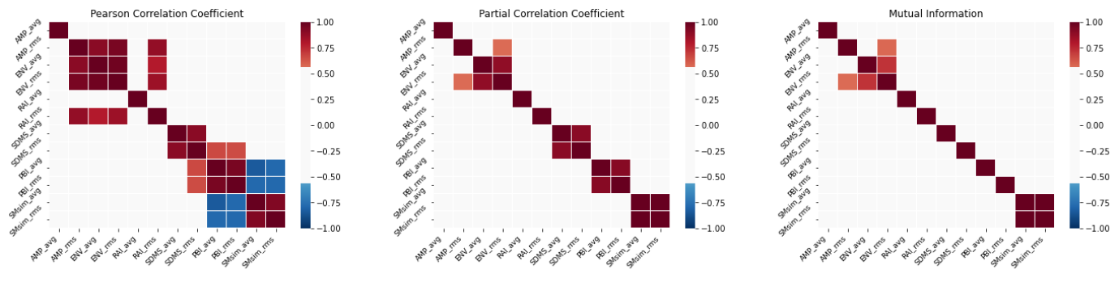
Seismic Data Redundancy
Seismic engineered features Pearson product-moment correlation (left), partial correlation coefficient (center), and mutual information (right).
envelope, parallel bed indicator, smooth similarity all indicate strong average and dispersion positive relationship (proportional effect)
significant negative correlation between parallel bed indicator and smooth similarity

Slide 22
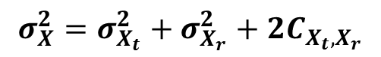
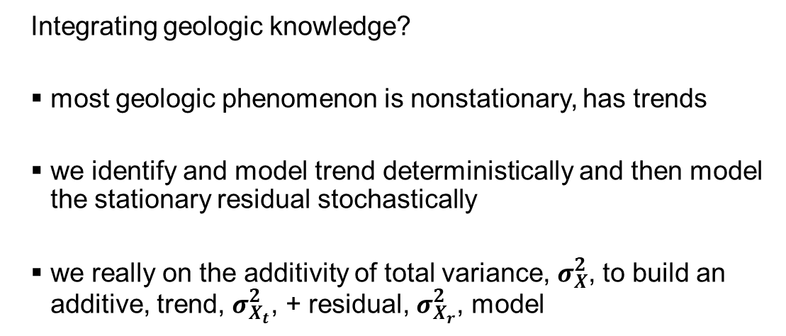
Deterministic Trends and Stochastic Residuals
20
Integrating geologic knowledge?
most geologic phenomenon is nonstationary, has trends
we identify and model trend deterministically and then model the stationary residual stochastically
we really on the additivity of total variance, $σ_{X}^{2}$, to build an additive, trend, $σ_{X_{t}}^{2}$, + residual, $σ_{X_{r}}^{2}$, model
15
Vsh(%)
10
5
v(u₁)
v(u₂)
v(u₃)
u₀
v(u₄)
v(u₅)
X(m)
20
15
Vsh(%)
10
$$σ_{X}^{2}=σ_{X_{t}}^{2}+σ_{X_{r}}^{2}+2C_{X_{t},X_{r}}$$
Known
Trend
5
Unknown
Residual
v(u₁)
v(u₂)
v(u₃)
u₀
v(u₄)
v(u₅)
X(m)
No trend spatial estimates (above) and with trend and residual spatial estimates (below).

Slide 23
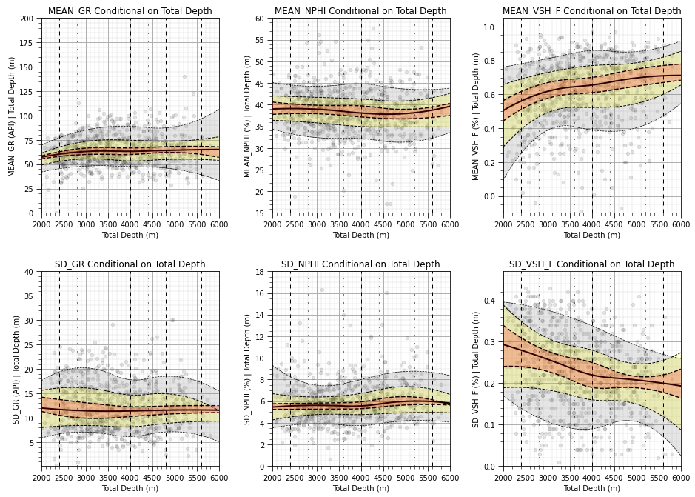
Well Data Vertical Trends
Trends in our data?
consistent gamma ray with depth
significant increase in fraction of shale with depth
Well vertical trends by total vertical depth, P40-P60 (orange), P25-P75 (yellow), P10-P90 (grey).

Slide 24
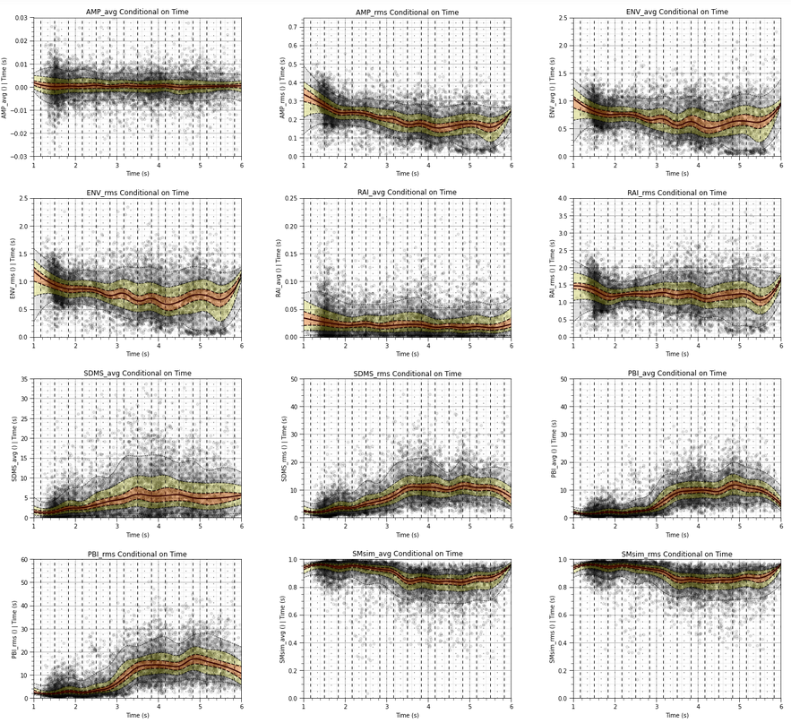
Seismic Data Vertical Trends
Trends in our data?
increasing relative acoustic impedance dispersion with depth
significant increase in parallel bed indicator, average and dispersion with depth
Seismic data vertical trends by total vertical depth, P40-P60 (orange), P25-P75 (yellow), P10-P90 (grey).

Slide 25
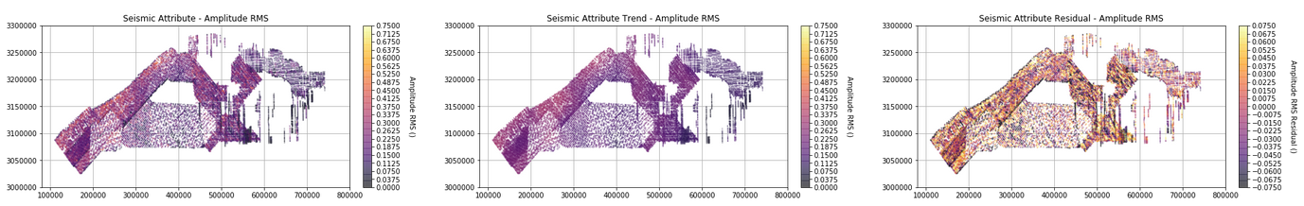
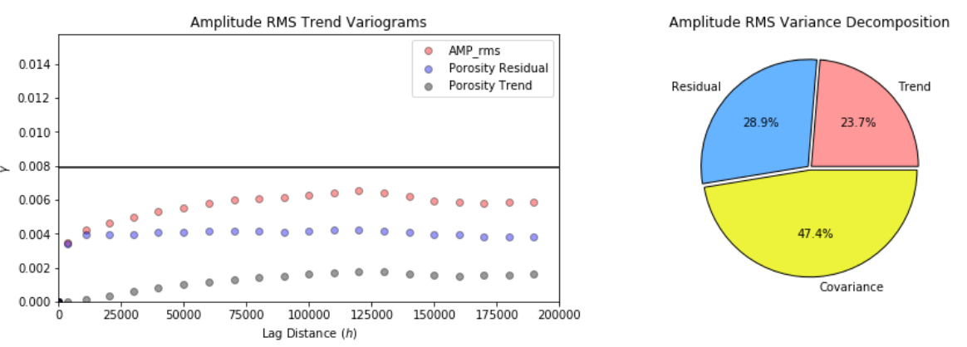
Seismic Feature Spatial Trend Models
Example blocked seismic attribute, seismic attribute trend model and seismic attribute residual model.
smooth trend model with Gaussian kernel
kernel size tuned by analysis of variance with decomposition/additivity of variance between trend and residual
Trend model checks, original, trend and residual variograms (left) and variance decomposition (right).

Slide 26

Geostatistical Spatial Estimation
Building spatial models?
kriging integrates local information, spatial continuity from the variogram, data redundancy and closeness.
provides a measure of estimation uncertainty, known as the estimation or kriging variance
$$\left[\begin{matrix}C\left(u_{1},u_{1}\right) & C\left(u_{1},u_{2}\right) & C\left(u_{1},u_{3}\right) \\ C\left(u_{2},u_{1}\right) & C\left(u_{2},u_{2}\right) & C\left(u_{2},u_{3}\right) \\ C\left(u_{3},u_{1}\right) & C\left(u_{3},u_{2}\right) & C\left(u_{3},u_{3}\right)\end{matrix}\right]\left[\begin{matrix}λ_{1} \\ λ_{2} \\ λ_{3}\end{matrix}\right]=\left[\begin{matrix}C\left(u,u_{1}\right) \\ C\left(u,u_{2}\right) \\ C\left(u,u_{3}\right)\end{matrix}\right]$$
redundancy
closeness
Illustration of the simple kriging system of equations with spatial continuity from the variogram, data redundancy and closeness.

Slide 27
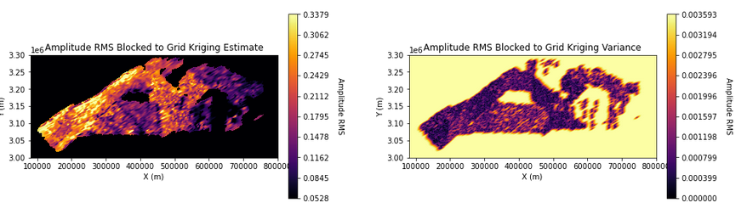
Seismic Feature Spatial Models with Uncertainty
Example blocked seismic attribute spatial estimates (left) and estimation variance, uncertainty (right).
simple kriging of residual plus deterministic trend
kriging estimates and kriging estimation variance for each seismic feature

Slide 28
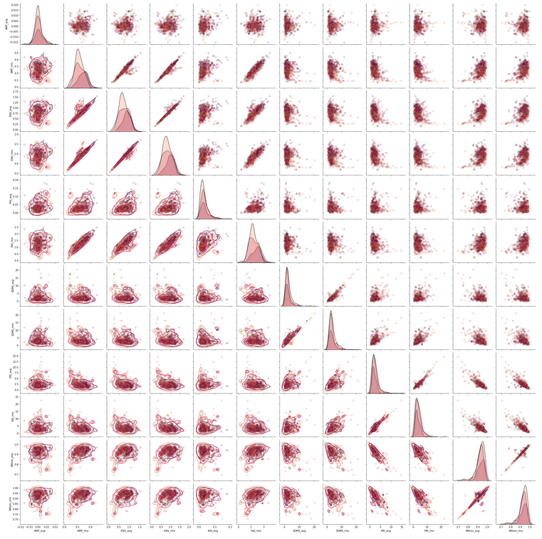
Well and Seismic Data Integration
linear, nonlinear, multimodal, homoscedastic, and heteroscedastic behaviors
variability over net pay thickness
Well and seismic features combined in a matrix scatter plot grouped by net pay thickness.

Slide 29
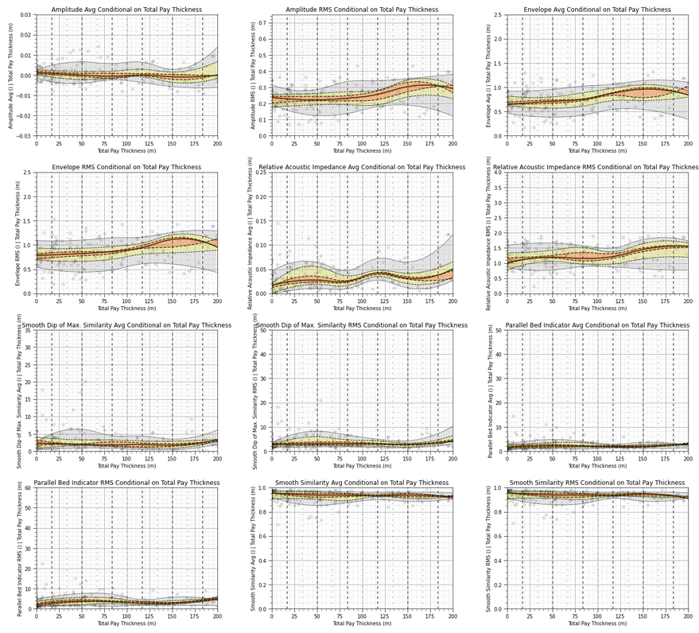
Relationships Between Seismic Attributes and Total Pay Sand
increasing relative acoustic impedance RMS with increase in effective porosity.
Seismic data relationship with total pay sand, P40-P60 (orange), P25-P75 (yellow), P10-P90 (grey).

Slide 30
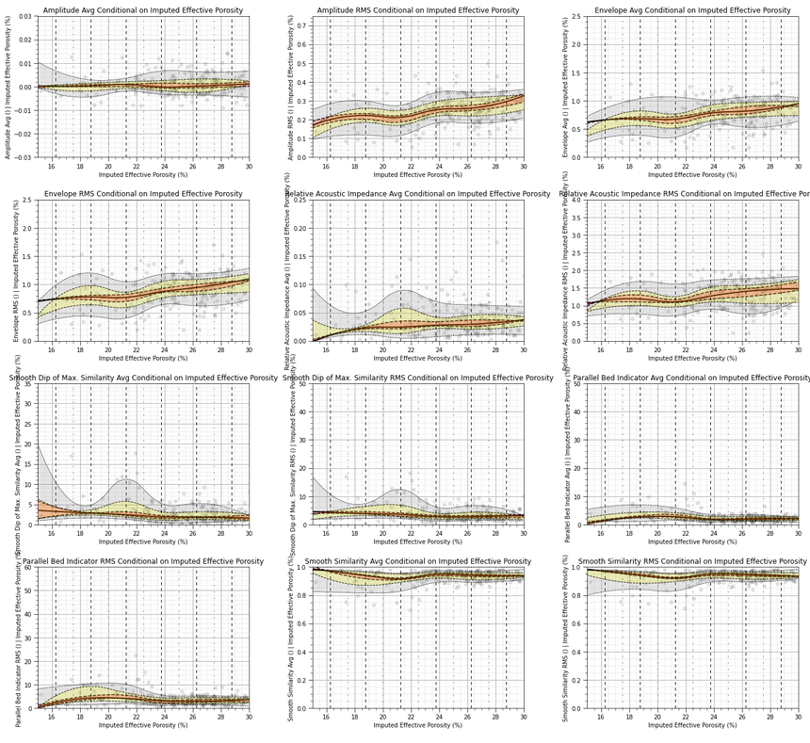
Relationships Between Seismic Attributes and Imputed Effective Porosity
increasing amplitude RMS, envelope RMS, relative acoustic impedance RMS with increase in effective porosity.
Seismic data relationship with effective porosity, P40-P60 (orange), P25-P75 (yellow), P10-P90 (grey).

Slide 31
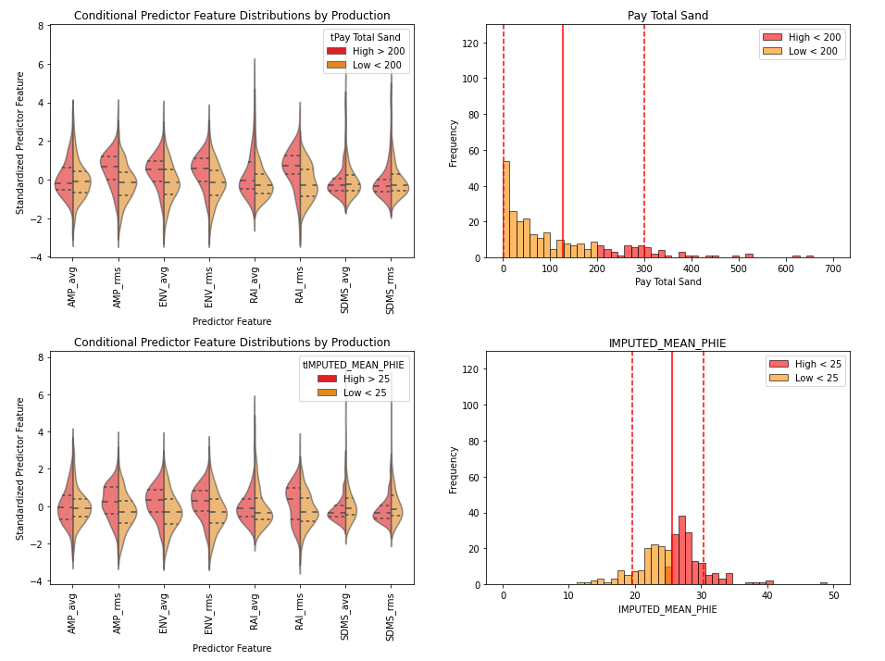
Well and Seismic Data Integration
What features are most important?
similar conditional P25, P50 and P75 for each seismic feature for low and high total sand thickness.
significant changes over the tails of the feature distributions.
Violin plot of seismic engineered features to pay total sand thickness and effective porosity.

Slide 32
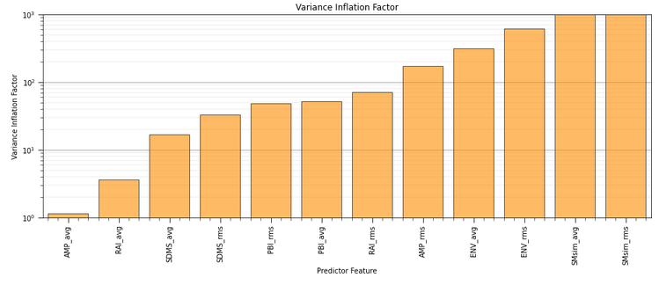
Feature Importance by Variance Inflation Factor
variance inflation factor
assumes linear, only account for redundancy between predictor features
finds the most linearly unique feature
Engineering seismic feature ranking by variance inflation factor.

Slide 33
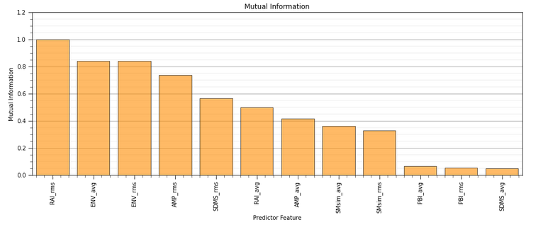
Feature Importance by Mutual Information
mutual information between each seismic engineered featured and total sand thickness
no linear assumption, only accounts for the pairwise relationship between the predictor and the response feature.
finds the feature with the most information shared with the response feature.
Engineering seismic feature ranking by bivariate pairwise mutual information.

Slide 34
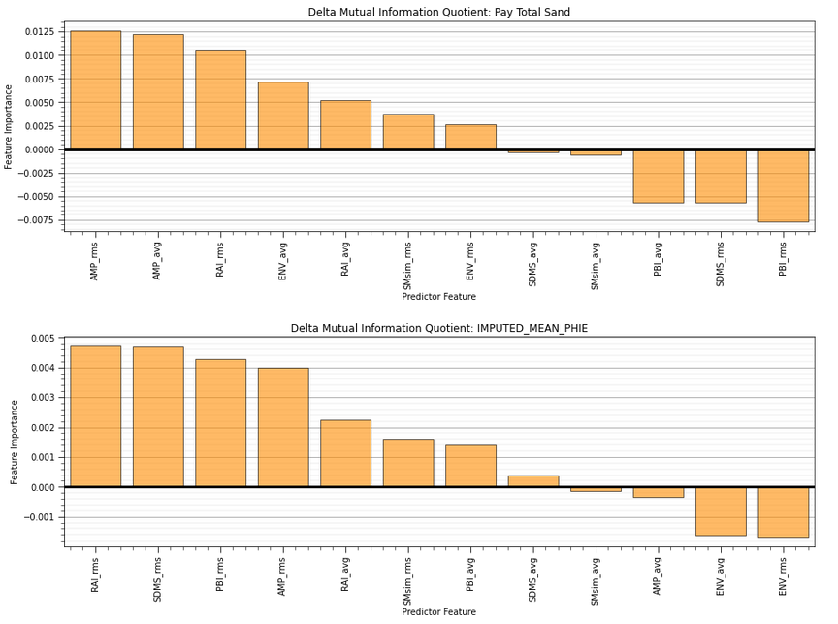
Feature Importance by Delta Mutual Information Quotient
change in mutual information quotient by adding each predictor feature
accounts for information shared between predictor features (redundancy) and between the predictor feature and the response feature (relevance)
no linear assumption, and accounts for relevance and redundancy.
Engineering seismic feature ranking by delta mutual information quotent.

Slide 35
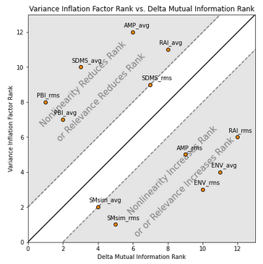
Feature Importance Comparison
Impact of new metrics?
useful to compare the engineered seismic feature ranks from various metrics
for example comparison of correlation coefficient and rank correlation coefficient indicates issues with outliers
high variance inflation factor and low mutual information may indicate issues with the linear assumption
Comparison of engineering seismic feature ranks by variance inflation factor and delta mutual information quotient (1 – lowest, n – highest rank).

Slide 36
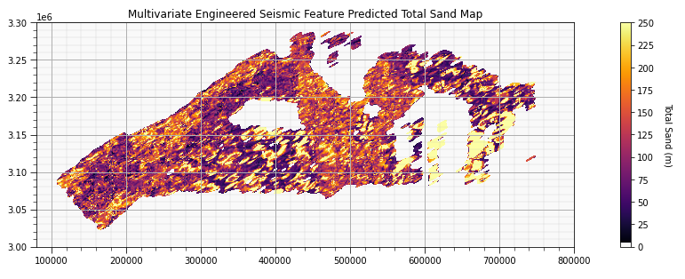
Multivariate Engineered Seismic Feature Machine Learning-based Model
Predicted total sand with multivariate engineered seismic feature machine learning-based model.
machine learning-based model supported by geostatistical analysis, scale, and uncertainty, spatial estimation with uncertainty of engineered seismic features.

Slide 37
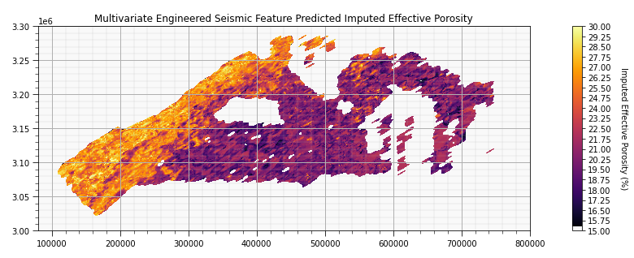
Multivariate Engineered Seismic Feature Machine Learning-based Model
Predicted total sand with multivariate engineered seismic feature machine learning-based model.
machine learning-based model supported by geostatistical analysis, scale, and uncertainty, spatial estimation with uncertainty of engineered seismic features.

Slide 38
Thank you! Any Questions?

